Slide 1
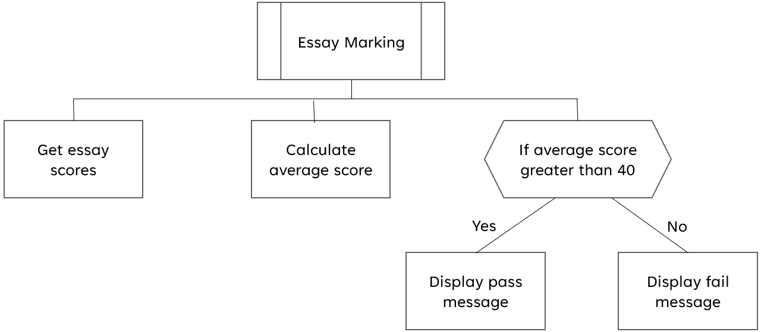
Starter Task
Complete the two tasks on your worksheet.
Add money to your account
Username:
Password:
Amount to add:
Add Money
Your new balance is:
Wireframe Example
Structure Diagram Example

Slide 2
Learning intentions and success criteria
I am learning…
I can…
About the design stage of software development
How to read and create flowcharts
Describe the design phase and the aspects of software analysis
Design flowcharts according to a program specification

Slide 3
Basic Worked Example
A program which asks the user for a temperature in Celsius, converts it to Fahrenheit, and displays the converted temperature to the user.
Temperature Converter
Get temperature in Celsius
Convert Celsius to Fahrenheit
Display temperature in Fahrenheit

Slide 4
Worked Example with Condition
A program for an English teacher to enter the last 3 essay scores for a pupil, calculate the average and then display the pass/fail result.
If the average is over 40, then student will achieve a pass for this work.
Essay Marking
Get essay scores
Calculate average score
If average score greater than 40
Yes
No
Display pass message
Display fail message

Slide 5
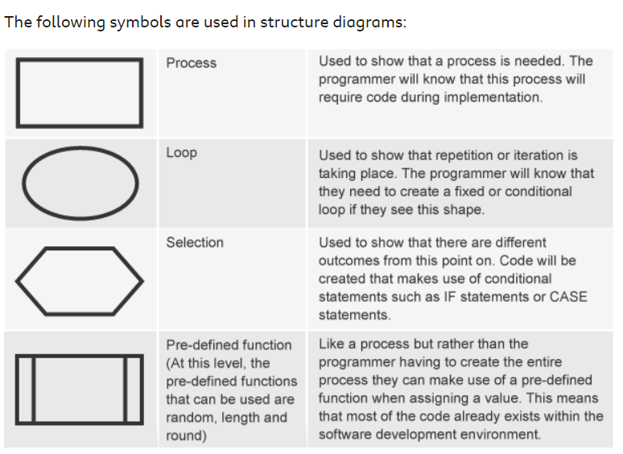
Structure Diagram
The following symbols are used in structure diagrams:

Slide 6
Example with Conditional Loop
A travel program which asks the user for the number of guests.
The program loops until all guests’ names are entered.
Display the list of guests at the end.
Travel Program
Get number of guests
Repeat until no guests left
Display list of names
Get name of guests

Slide 7
Example with Fixed Loop
A program for a nursery class that will help with their counting.
It will ask the pupil to type their name and then type the number of times it is to be repeated.
The name will then be displayed that number of times.
Counting Program
Get name
Get number of times to repeat
Repeat number of times entered
Display name

Slide 8
Worksheet Part 3: Loops
Identify the Inputs, Processes, and Outputs, then design the following programs using structure diagrams:
A program which counts down from a number. The user enters a number to count down from, then the program loops, starting from the user’s number and displaying it, until it reaches zero.
A program which asks the user to enter a number, then loops, displaying a times table for that number up to times 12.

Slide 9

Flowcharts
N5 - Software Design & Development

Slide 10
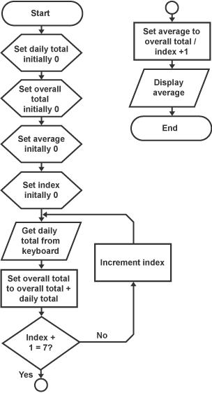
Introduction
During the design phase, flowcharts can be used instead of structure diagrams:
Flowcharts are another example of a visual design technique
Different shaped boxes connected with arrows to show each step in a program
Reads from Start to End, from top to bottom

Slide 11
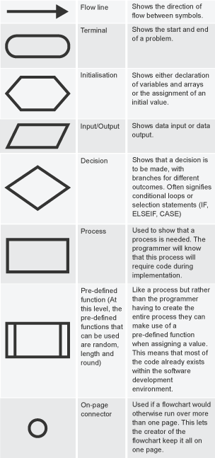
Symbols
Different shapes in a flowchart indicate different concepts in a computer program:

Slide 12
Basic Example 1
A program which asks the user for their name and displays “Hello” and their name.
Start
Begin with Start
Initialise a name variable
Get the user’s name (input/output)
Display message (input/output)
Finish with End
Set name initially “”
Get name from keyboard
Display “Hello” + name
End

Slide 13
Basic Example 2
Start
Set num1, num2 initially 0
A program which asks the user for 2 numbers, then adds them together and displays the total to the user.
Set total initially 0
Get num1 from keyboard
Initialise the variables we need (num1, num2 and total)
Get num1 and num2 from user
Set total (num1 + num2)
Display total
Get num2 from keyboard
Set total to num1 + num2
Display total
End

Slide 14
Basic Flowchart Tasks
Design the following programs using Flowcharts:
A program which asks the user for the length and width of a rectangle, then calculates its area and displays it to the user.
A program which asks for 2 numbers and calculates the average of the two.
A program which asks for the user’s name and age, then displays “Your name is” + name + “and you are” + age.

Slide 15
Conditions in Flowcharts
Start
A program which asks the user for their age.
If over 18, display “You are an adult”, otherwise display “You are a child”.
Set age initially 0
Get age from keyboard
Initialise the variables we need (age)
Get age from user
Check if age > 18
If yes, display adult message
If no, display child message
If age > 18
Yes
No
Display “You are an adult”
Display “You are a child”
End

Slide 16
Condition Flowchart Tasks
Design the following programs using Flowcharts:
A program which asks the user for their age. If over 17, display “Can learn to drive”, otherwise display “Can’t learn to drive”.
A program which asks the user for the temperature. If it is over 20, display “Hot”, otherwise display “Cold”.
A program which asks the user for two numbers. If the first number is greater than the second, display “First number bigger”, otherwise display “Second number bigger”.

Slide 17
Loops in Flowcharts
Loops are notated using an arrow going back to another process.
There may be additional processes before going back to the start of the loop.
This example shows a conditional loop (loops until the index is 7).

Slide 18
Course Specification
In National 5, you must be able to:
Read and understand all three design techniques
  Structure diagrams
  Flowcharts
  Pseudocode
Exemplify and implement ONE of the design techniques to design efficient solutions to a problem
Describe, exemplify, and implement user interface design in terms of input and output, using a Wireframe

Slide 19
Learning intentions and success criteria
I am learning…
I can…
About the design stage of software development
How to read and create structure diagrams
Describe the design phase and the aspects of software analysis
Design structure diagrams according to a program specification

